Slide 1
Lập trình ứng dụng mobile (Spring 2020)
Session1: Introduction
Instructor: Nguyen Tri Nhan

Slide 2
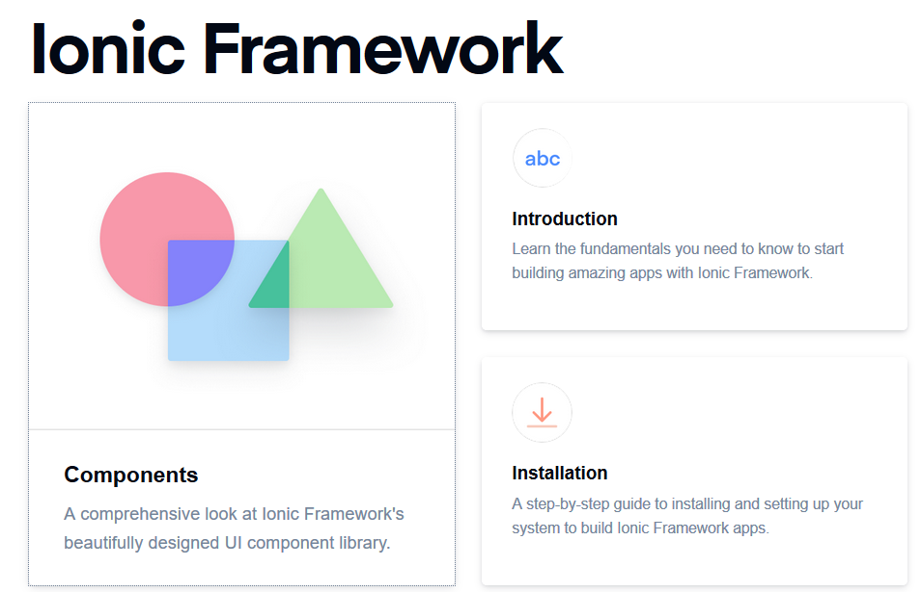
Ionic Framework

Slide 3
What is Ionic Framework?
Goals
License
Ionic CLI
Framework Compatibility
Ionic Framework V4+
Ionic Appflow
Ecosystem

Slide 4
What is Ionic Framework?
Ionic Framework is an open source UI toolkit for building performant, high-quality mobile and desktop apps using web technologies (HTML, CSS, and JavaScript).
Ionic Framework is focused on the frontend user experience, or UI interaction of an app (controls, interactions, gestures, animations). It’s easy to learn, and integrates nicely with other libraries or frameworks, such as Angular, or can be used standalone without a frontend framework using a simple script include.
Currently, Ionic Framework has official integrations with Angular and React, and support for Vue is in development. If you’d like to learn more about Ionic Framework before diving in, we created a video to walk you through the basics.

Slide 5
Goals
Cross-platform
Build and deploy apps that work across multiple platforms, such as native iOS, Android, desktop, and the web as a Progressive Web App - all with one code base. Write once, run anywhere.
Web Standards-based
Ionic Framework is built on top of reliable, standardized web technologies: HTML, CSS, and JavaScript, using modern Web APIs such as Custom Elements and Shadow DOM. Because of this, Ionic components have a stable API, and aren't at the whim of a single platform vendor.

Slide 6
Goals
Beautiful Design
Clean, simple, and functional. Ionic Framework is designed to work and display beautifully out-of-the-box across all platforms. Start with pre-designed components, typography, interactive paradigms, and a gorgeous (yet extensible) base theme.
Simplicity
Ionic Framework is built with simplicity in mind, so that creating Ionic apps is enjoyable, easy to learn, and accessible to just about anyone with web development skills.

Slide 7
License
Ionic Framework is a free and open source project, released under the permissable MIT license. This means it can be used in personal or commercial projects for free. MIT is the same license used by such popular projects as jQuery and Ruby on Rails.
This documentation content (found in the ionic-docs repo) is licensed under the Apache 2 license.

Slide 8
Ionic CLI
The official Ionic CLI, or Command Line Interface, is a tool that quickly scaffolds Ionic apps and provides a number of helpful commands to Ionic developers. In addition to installing and updating Ionic, the CLI comes with a built-in development server, build and debugging tools, and much more. If you are an Ionic Appflow member, the CLI can be used to perform cloud builds and deployments, and administer your account.

Slide 9
Framework Compatibility
While past releases of Ionic were tightly coupled to Angular, V4 of the framework was re-engineered to work as a standalone Web Component library, with integrations for the latest JavaScript frameworks, like Angular. Ionic can be used in most frontend frameworks with success, including React and Vue, though some frameworks need a shim for full Web Component support.

Slide 10
JavaScript
One of the main goals with Ionic 4 was to remove any hard requirement on a single framework to host the components. This means the core components can work standalone with just a script tag in a web page. While working with frameworks can be great for larger teams and larger apps, it is now possible to use Ionic as a standalone library in a single page even in a context like WordPress.

Slide 11
Future Support
Support for other frameworks are expected in future release. Currently official bindings for Vue are being developed, though some components just work out of the box in those frameworks.

Slide 12
Ionic Framework V4+
Ionic Framework V4 is a major advance in the underlying technology and capabilities of the project, with a focus on performance, compatibility, and overall extensibility. Although V4 still integrates deeply with Angular through the @ionic/angular package, it is now also framework-agnostic, meaning it can work with any other JavaScript framework (Vue, React, Preact, etc), or with no framework at all.
By moving to web standards, V4 allows the core of Ionic to rely on the standard component model supported in modern browsers, rather than a framework-specific model. This can mean faster load time, better performance, and less overall code.

Slide 13
Ionic Appflow
To help manage Ionic apps throughout their lifecycle, we also offer a commercial app platform for production apps called Ionic Appflow, which is separate from the open source Framework.
Ionic Appflow helps developers and teams compile native app builds and deploy live code updates to Ionic apps from a centralized dashboard. Optional paid upgrades are available for more advanced capabilities like workflow automation, single sign-on (SSO) and access to connected services and integrations.
Appflow requires an Ionic Account and comes with a free “Starter” plan for those interested in playing around with some of its features.

Slide 14
Ecosystem
Ionic Framework is actively developed and maintained full-time by a core team, and its ecosystem is guided by an international community of developers and contributors fueling its growth and adoption. Developers and companies small and large use Ionic to build and ship amazing apps that run everywhere.

Slide 15
Join the Community
There are millions of Ionic developers in over 200 countries worldwide. Here are some ways to join:
Forum: A great place for asking questions and sharing ideas.
Slack: A lively place for devs to meet and chat in real time.
Twitter: Where we post updates and share content from the Ionic community.
GitHub: For reporting bugs or requesting new features, create an issue here. PRs welcome!
Content authoring: Write a technical blog or share your story with the Ionic community.

Slide 16
Core Concepts
Contents
UI Components
Adaptive Styling
Navigation
Native Access
Theming

Slide 17
Core Concepts
For those completely new to Ionic app development, it can be helpful to get a high-level understanding of the core philosophy, concepts, and tools behind the project. Before diving into complex topics, we'll cover the basics of what Ionic Framework is, and how it works.

Slide 18
UI Components
Ionic Framework is a library of UI Components, which are reusable elements that serve as the building blocks for an application. Ionic Components are built with web standards using HTML, CSS, and JavaScript. Though the components are pre-built, they're designed from the ground up to be highly customizable so apps can make each component their own, allowing each app to have its own look and feel. More specifically, Ionic components can be easily themed to globally change appearance across an entire app. For more information about customizing the look, please see Theming.

Slide 19
Adaptive Styling
Adaptive Styling is a built-in feature of Ionic Framework which allows app developers to use the same code base for multiple platforms. Every Ionic component adapts its look to the platform on which the app is running on. For example, Apple devices, such as the iPhone and iPad, use Apple's own iOS design language. Similarly, Android devices use Google's design language called Material Design.
By making subtle design changes between the platforms, users are provided with a familiar app experience. An Ionic app downloaded from Apple's App Store will get the iOS theme, while an Ionic app downloaded from Android's Play Store will get the Material Design theme. For the apps that are viewed as a Progressive Web App (PWA) from a browser, Ionic will default to using the Material Design theme. Additionally, deciding which platform to use in certain scenarios is entirely configurable. More information about adaptive styling can be found in Theming.

Slide 20
Navigation
@ionic/angular
Traditional web apps use a linear history, meaning that the user navigates forward to a page and can hit the back button to navigate back. An example of this is clicking around Wikipedia where the user is going forward and backward on the browser's linear history stack.
In contrast, mobile apps often utilize parallel, "non-linear" navigation. For example, a tabbed interface can have separate navigation stacks for each tab, making sure the user never loses their place as they navigate and switch between tabs.
Ionic apps embrace this mobile navigation approach, supporting parallel navigation histories that can also be nested, all while maintaining the familiar browser-style navigation concepts web developers are familiar with.
For apps that are built with Angular and Angular Router: (@ionic/angular) which comes out of the box for every new Ionic 4 Angular app.

Slide 21
Native Access
An amazing feature of apps built with web technologies (such as Ionic apps!) is that it can run on virtually any platform: desktop computers, phones, tablets, cars, refrigerators, and more! The same code base for Ionic apps can work on many platforms because it is based on web standards and common APIs that are shared across these platforms.
One of the most common use cases for Ionic is to build an app which can be downloaded from both the App Store and Play Store. Both iOS and Android software development kits (SDKs) provide Web Views which render any Ionic app, while still allowing for full Native SDK access.
Projects such as Capacitor and Cordova are commonly used to give Ionic apps this access to Native SDKs. This means developers can quickly build out an app using common web development tools, and still have access to native features such as the device's accelerometer, camera, GPS, and more.

Slide 22
Theming
At the core, Ionic Framework is built using CSS which allows us to take advantage of the flexibility that CSS properties (variables) provide. This makes it incredibly easy to design an app that looks great while following the web standard. We provide a set of colors so developers can have some great defaults, but we encourage overriding them to create designs that match a brand, company or a desired color palette. Everything from the background color of an application to the text color is fully customizable. More information on app theming can be found in Theming.

Slide 23
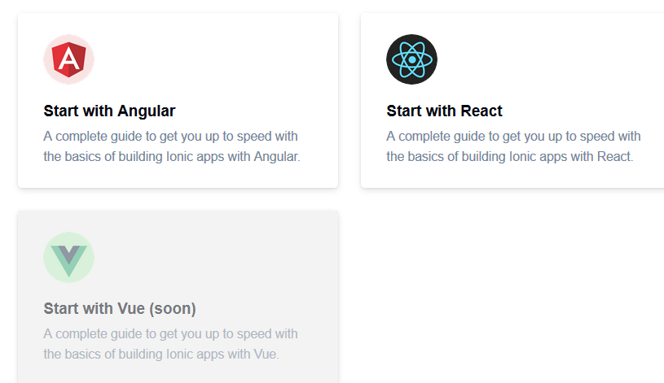
Build Your First App Tutorial Pick the JavaScript framework you plan to use while building your Ionic app:

Slide 24
Browser Support
Contents
Mobile Browsers
Desktop Browsers
Ionic's earliest goal was to make it easy to develop mobile apps using web technologies like HTML, CSS, and JavaScript. Because of this foundation in web technologies, Ionic can run anywhere the web runs — iOS, Android, browsers, Electron, PWAs, and more.

Slide 25
Mobile Browsers
In pursuit of adaptive styling, Ionic fully supports and is well tested on the mobile platforms listed below:
Framework | Android | iOS
Ionic V5 | 5.0+ | 11.0+
Ionic V4 | 4.4+ | 10.0+
Check the latest Android stats and the latest iOS stats for up-to-date platform information.

Slide 26
Desktop Browsers
Browser | Ionic v5 | Ionic V4
Chrome | ✔ | ✔
Safari | ✔ | ✔
Edge | 79+ | ✔
Firefox | ✔ | ✔
IE 11 | X | ✔
Check the docs for Ionic Animations and Ionic Gestures for specific browser support related to those utilities.

Slide 27
Versioning
Contents
Release Schedule
Changelog
Ionic Framework follows the Semantic Versioning (SemVer) convention: major.minor.patch.
Incompatible API changes increment the major version, adding backwards-compatible functionality increments the minor version, and backwards-compatible bug fixes increment the patch version.

Slide 28
Release Schedule
Major Release
A major release will be published when there is a breaking change introduced in the API. Major releases will occur roughly every 6 months and may contain breaking changes. Several release candidates will be published prior to a major release in order to get feedback before the final release. An outline of what is changing and why will be included with the release candidates.

Slide 29
Minor Release

Slide 30
Question???

